Slide 1

“Automatic Fish Classification for Underwater Species Behavior Understanding” Review
Gonçalo Adolfo
Instituto superior Técnico, Universidade de Lisboa

Slide 2
Outline
Introduction ideas
Trajectory analysis system
Douglass Peucker algorithm
IKmeans
Results/Improvements
Doubts relative to the approach

Slide 3
Introduction ideas
Human underwater observation
Underwater cameras installation
Manual analysis
Invasive
Amount of data
Tedious
Error prone

Slide 4
Trajectory Analysis System
Preprocessing (Douglass Peucker)
Trajectories split
Clustering algorithm (IKmeans)
Events of interest identification
Underlying modules: detection, tracking and classification

Slide 5
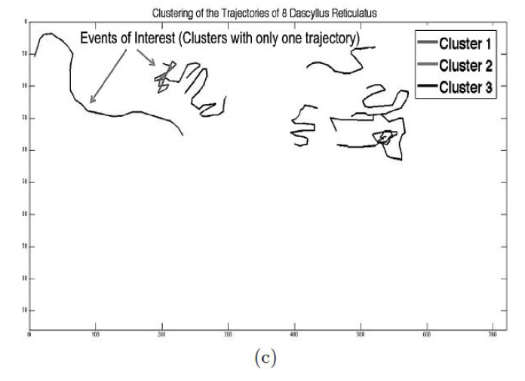
Events of interest

Slide 6
Douglass Peucker Algorithm
1) Mark first and last point to be kept
2) Get the farthest point to the line segment
3) if distance ≤ ε : the points in between are excluded
if distance > ε : the farthest point is kept; apply first and second steps to the line
segments starting point, farthest point and farthest point, ending point

Slide 7
IKmeans
Clustering problems (time series):
Classic Kmeans
Proposed algorithm
high dimensionality, high feature correlation
need of choosing the number of clusters and high dependence of centroids initialization
takes advantage of the wavelet decomposition in order to represent a time series in different resolution levels

Slide 8
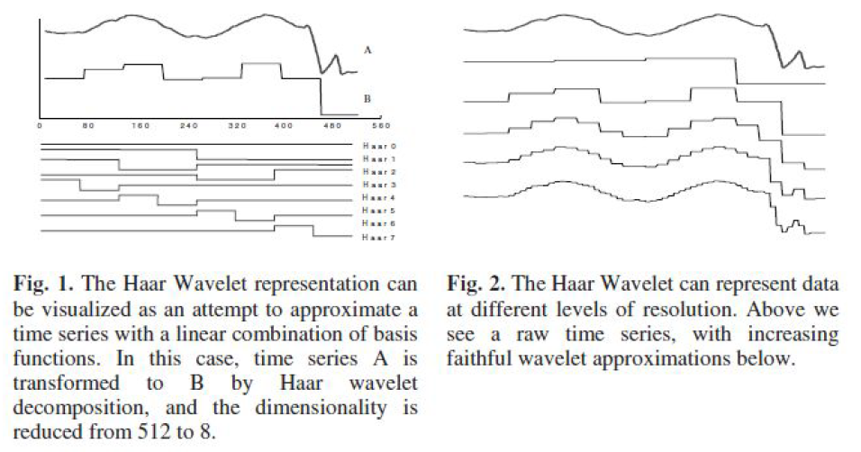
Haar wavelet decomposition
It’s achieved by averaging adjacent values, to form a smooth lower dimensional signal
Coefficients are important for reconstructing the original time series

Slide 9
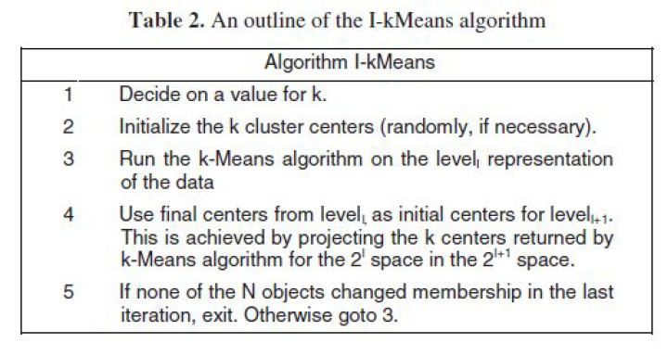
IKmeans
Apply kmeans at increasingly finer levels of resolution
Resulting centroids of the last level are used in the next one

Slide 10
Ikmeans (notes)
Algorithm starts on the second level (2i−1 dimensions) where i is the level
Intuition: the general shape of a time series can be approximately captured at a lower resolution
Typically stabilize at a low level thus less processing time
When iterating to the next level, the centroids will be better and consequently the number of iterations will be lower
The centroid values, when passed to the next level, have to be duplicated in order to
match its dimensionality (0.5, 1.2) → (0.5, 0.5, 1.2, 1.2)

Slide 11
Results/Improvements
Results
Improvements
IKmeans algorithm gave better results in terms of cluster quality and also performance (even if it reaches a high level of resolution)
Integrate species events (e.g. predador fish chasing small fish)

Slide 12
Doubts
Which distance metric is used? DTW?
How does the centroid is calculated in that case?

